Slide 1
Loan Eligibility Prediction
Done By:-
Prem Kumar. M
Franklin
Safeeq Rahman
Guide:-
Dr. Soumya

Slide 2
INTRODUCTION
This project is focused on developing a machine learning model for predicting loan eligibility to help improve the loan approval process and reduce potential bias and discrimination in the lending industry. With the increasing demand for loans and the complexity of assessing creditworthiness, automating the loan eligibility prediction process can help lenders make more efficient and accurate decisions.
The project will involve preprocessing and cleaning a dataset of loan applicant information, selecting appropriate machine learning algorithms, and evaluating model performance based on various metrics.
The significance of this project lies in its potential to benefit both lenders and loan applicants by providing an objective and data-driven approach to the loan approval process.

Slide 3
Data collection and Pre Processing
Our project uses a dataset collected from Kaggle. The dataset contains information about customers' demographics, financial history, credit score, and loan details. However, the dataset had missing data, which could lead to inaccurate predictions by our model. Therefore, our first step was to preprocess and clear the data.
We used two libraries, NumPy and Pandas, to preprocess the dataset. NumPy is used for array and mathematical operations, while Pandas is used to read and manipulate data in a tabular format.
We handled missing data by calculating the mean value for numerical variables and filling in the missing data with the mean value. For categorical variables, we filled in the missing data with the most frequent value or mode.

Slide 4
Data collection and Pre Processing
To make the data easier for the machine learning algorithm to understand, we converted strings to integers. For instance, we assigned a value of 1 to 'Educated' and a value of 0 to 'Uneducated'. This helped to make the data more interpretable by the machine learning algorithm.
In summary, our data collection and preprocessing involved handling missing data and converting strings to integers. These preprocessing steps were crucial in cleaning and preparing the dataset for training the machine learning algorithm.

Slide 5
Data Analysis
Before training our data, we needed to visually analyze the dataset to understand how the prediction was happening and to whom loans were given in the past history of the dataset.
To visualize the dataset, we used the Seaborn library, which is one of the commonly used libraries for data visualization.
We used various visualization techniques such as scatter plots, histograms, and bar graphs to understand the distribution of data, identify patterns, and relationships between variables.

Slide 6
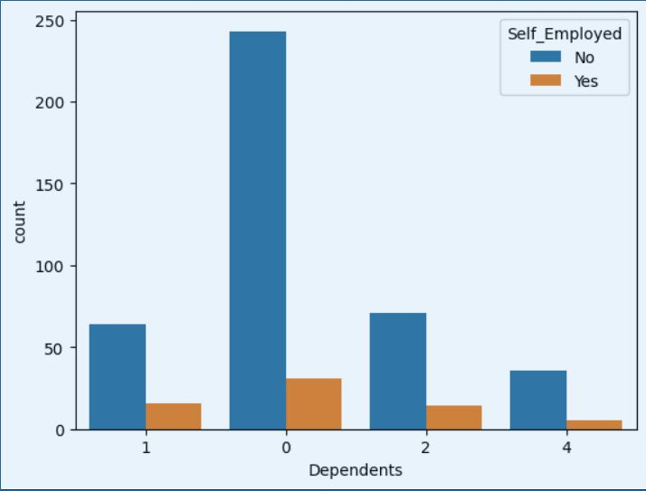
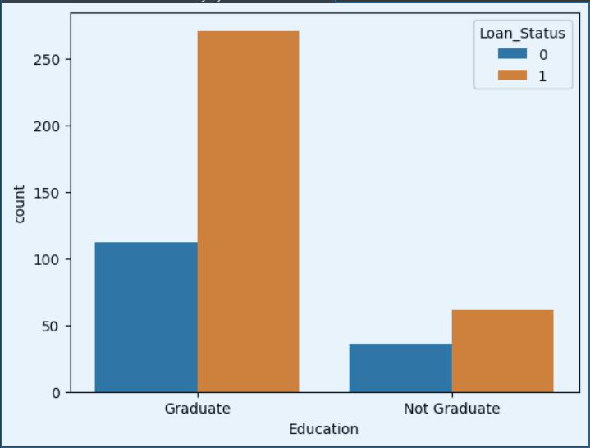
Data Analysis

Slide 7
Training model
Now that we have preprocessed and analyzed our dataset, it is time to train our model. Before training, we need to split our dataset into training data and testing data so that we can backtest our model with the test data.
To train our model, there are many algorithms available. For our loan eligibility prediction model, we have used the Support Vector Machine (SVM) model as it has given the highest accuracy.
We used the SVM algorithm to train our model on the training dataset. We then evaluated the performance of our model on the test dataset.

Slide 8
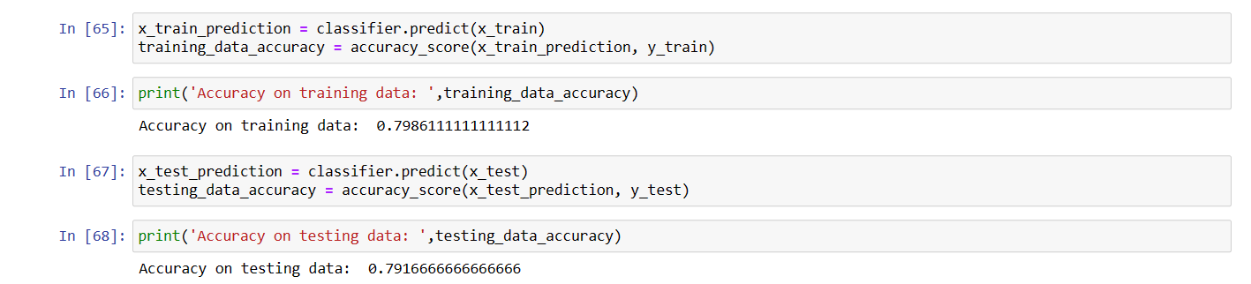
Training model
After training our model, we obtained an accuracy of 79.86% on the training dataset and an accuracy of 79.16% on the test dataset.
In summary, the training process involved splitting our dataset into training data and testing data, training our model using the SVM algorithm, and evaluating the performance of our model on the test dataset.

Slide 9
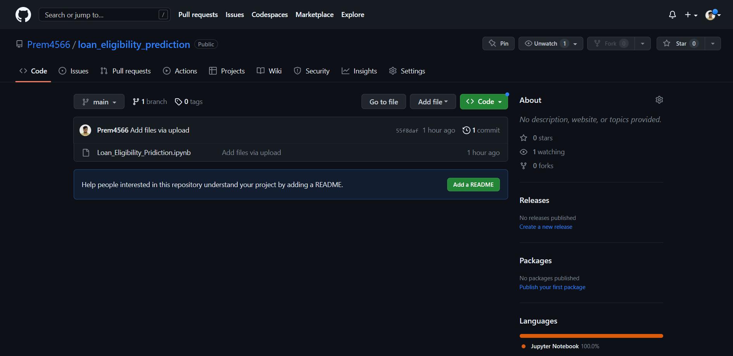
Github
Github Repository: https://github.com/Prem4566/loan_eligibility_prediction

